Slide 1
Introduction to
K Nearest Neighbors

Slide 2
KNN
K Nearest Neighbors is a classification algorithm that operates on a very simple principle.
It is best shown through example!
Imagine we had some imaginary data on Dogs and Horses, with heights and weights.

Slide 3
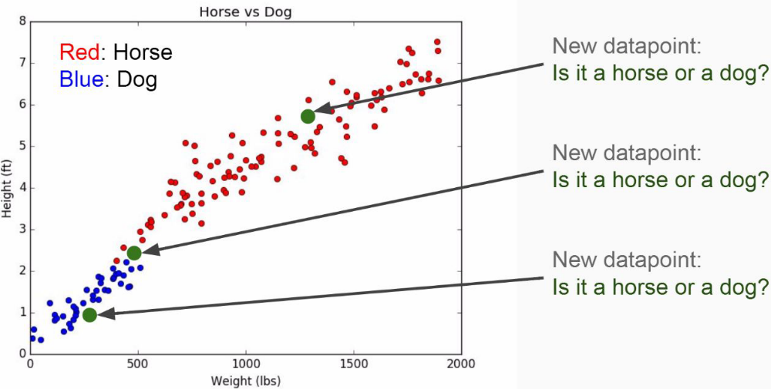
KNN

Slide 4
KNN
Training Algorithm:
  Store all the Data
Prediction Algorithm:
  Calculate the distance from x to all points in your data
  Sort the points in your data by increasing distance from x
  Predict the majority label of the “k” closest points

Slide 5
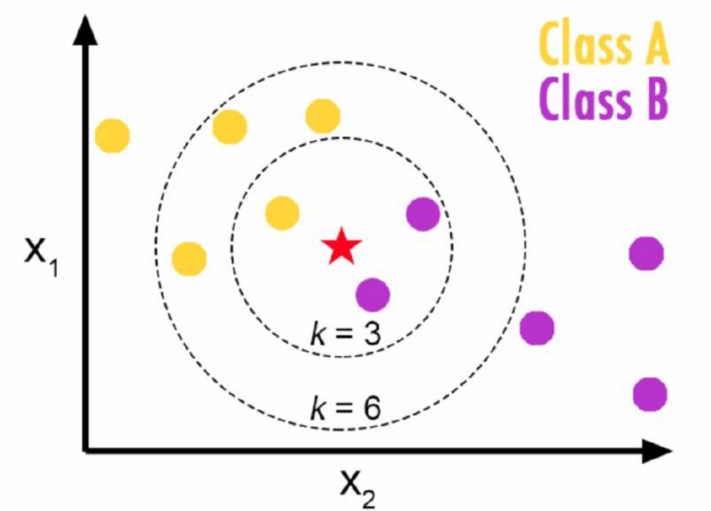
KNN
Choosing a K will affect what class a new point is assigned to:

Slide 6
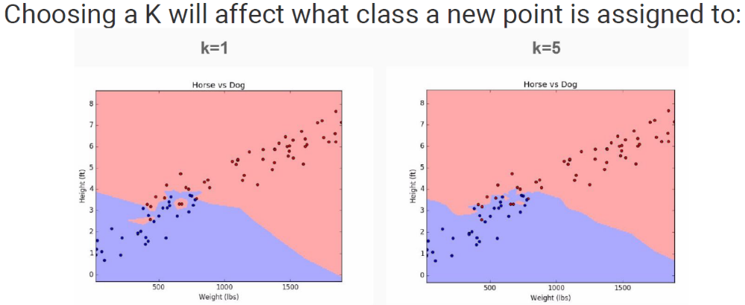
KNN

Slide 7
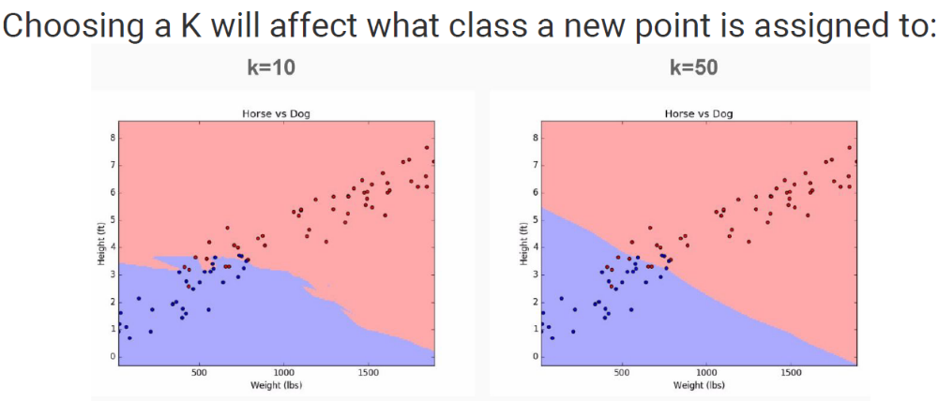
KNN

Slide 8
KNN
Pros
  Very simple
  Training is trivial
  Works with any number of classes
  Easy to add more data
  Few parameters
    K
    Distance Metric

Slide 9
KNN
Cons
  High Prediction Cost (worse for large data sets)
  Not good with high dimensional data
  Categorical Features don’t work well

